Slide 1
Object Oriented Programming

Slide 2
Definition
Object-oriented programming (OOP) is a programming paradigm based on the concept of "objects", which can contain data, in the form of fields (often known as attributes), and code, in the form of procedures (often known as methods)
Ref: Wikipedia

Slide 3
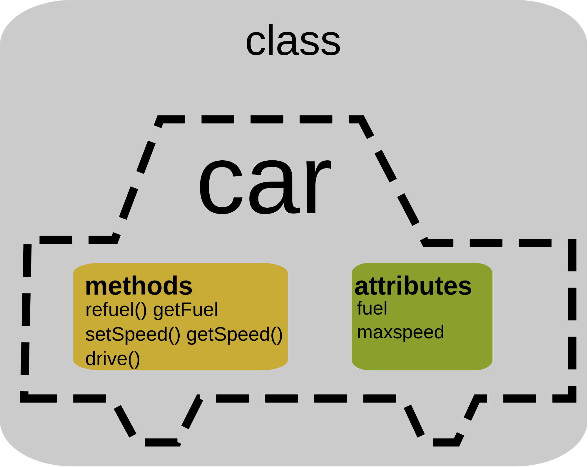
OOP

Slide 4
Programming paradigms
Programming paradigms are a way to classify programming languages based on their features. Languages can be classified into multiple paradigms.

Slide 5
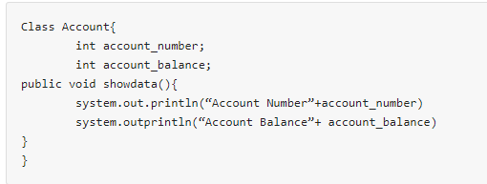
OOP (Java Class)

Slide 6
Core OOPS concepts
Class The class is a group of similar entities.
For example, if you had a class called “Expensive Cars” it could have objects like Mercedes, BMW, Toyota, etc.
Its properties(data) can be price or speed of these cars.
While the methods may be performed with these cars are driving, reverse, braking etc.

Slide 7
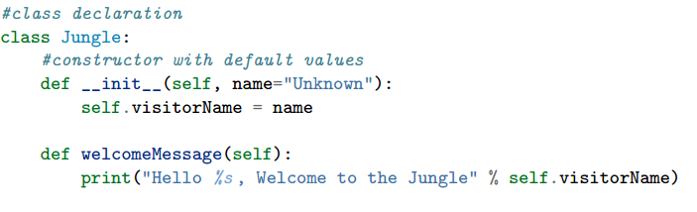
Python Class

Slide 8
Core OOPS concepts
2) Object
An object can be defined as an instance of a class, and there can be multiple instances of a class in a program.
An Object contains both the data and the function, which operates on the data.
For example - chair, bike, marker, pen, table, car, etc.

Slide 9
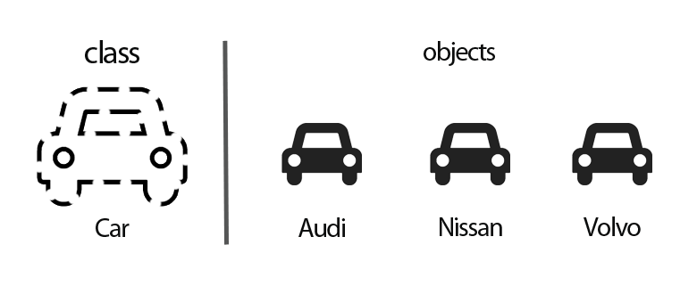
Class and Object

Slide 10
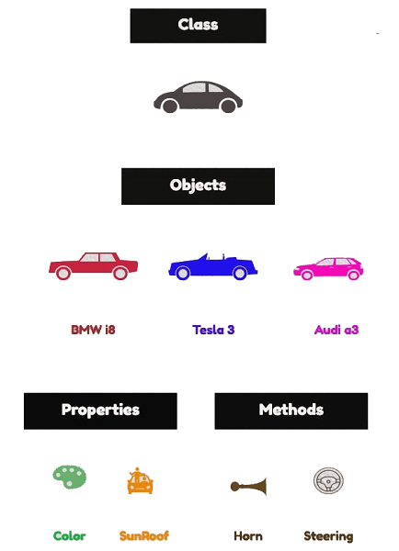
Class and Object

Slide 11
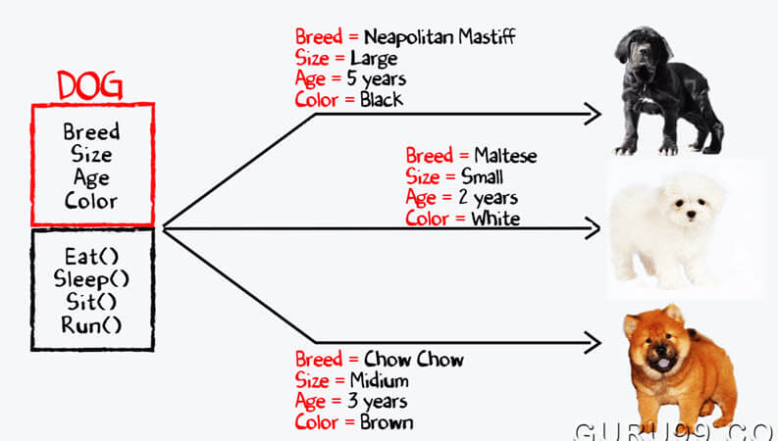
Class and Object

Slide 12
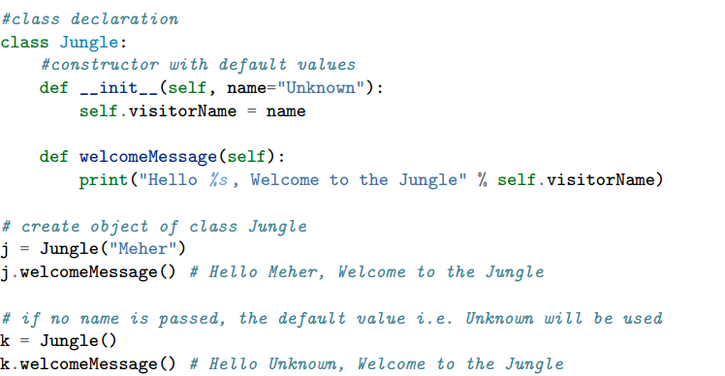
Python Object

Slide 13
Core OOPS concepts
3) Inheritance
Inheritance is an OOPS concept in which one object acquires the properties and behaviors of the parent object.
It’s creating a parent-child relationship between two classes.
It offers robust and natural mechanism for organizing and structure of any software.

Slide 14
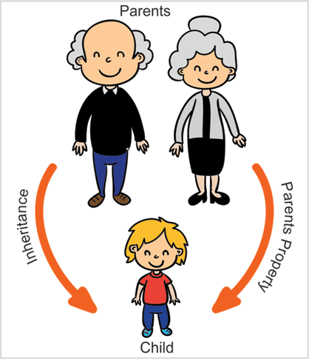
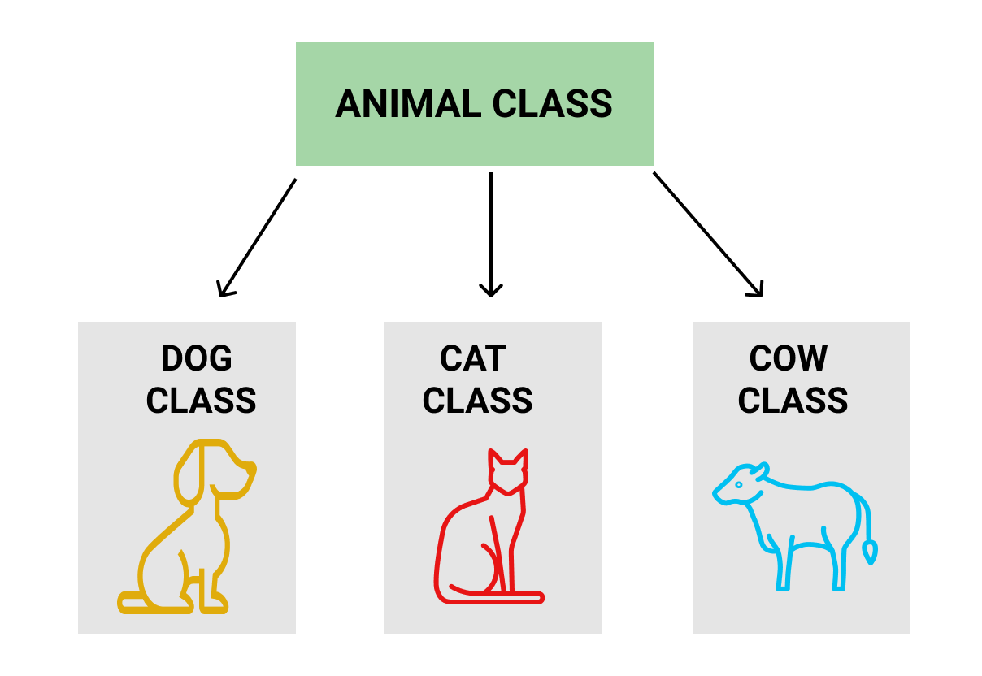
Inheritance

Slide 15
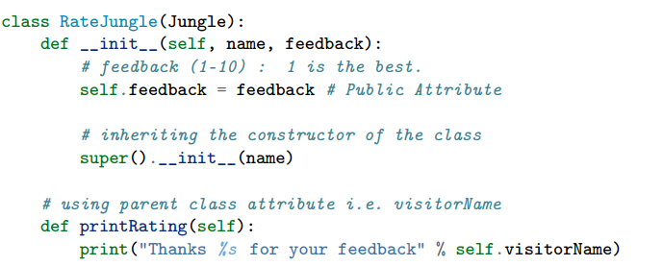
Python Inheritance

Slide 16
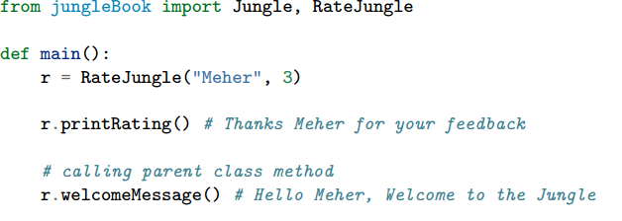
Python Inheritance

Slide 17
Core OOPS concepts
4) Polymorphism
Polymorphism refers to the ability of a variable, object or function to take on multiple forms.
For example, in English, the verb run has a different meaning if you use it with a laptop, a foot race, and business.
Here, we understand the meaning of run based on the other words used along with it. The same also applied to Polymorphism.

Slide 18
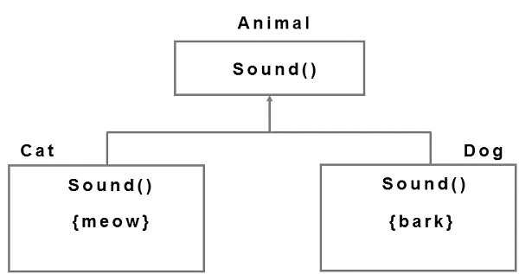


Polymorphism

Slide 19
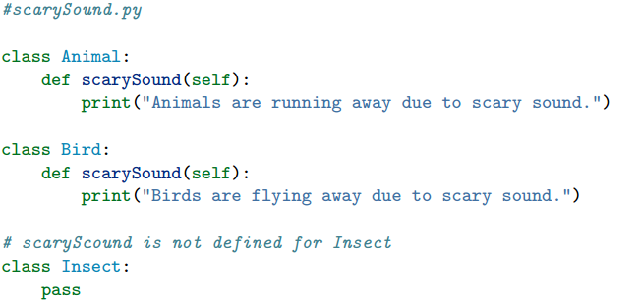
Python Polymorphism

Slide 20
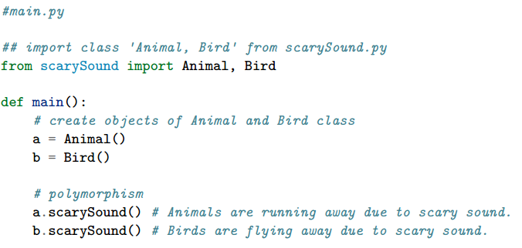
Python Polymorphism

Slide 21
Core OOPS concepts
5) Abstraction
An abstraction is an act of representing essential features without including background details.
It is a technique of creating a new data type that is suited for a specific application.
For example, while driving a car, you do not have to be concerned with its internal working. Here you just need to concern about parts like steering wheel, Gears, accelerator, etc.

Slide 22
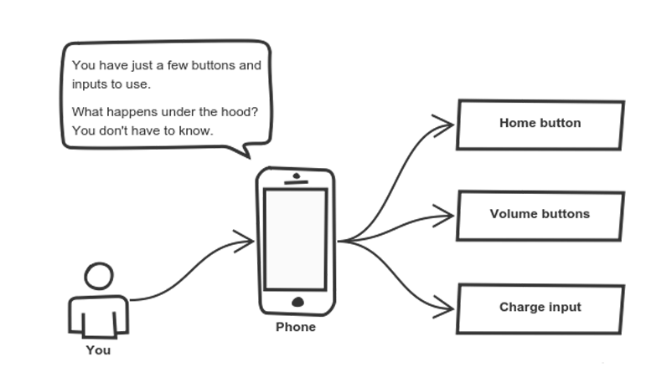
Abstraction

Slide 23
Abstraction
def main:
car = Tesla(“Version 2.0”)
car.start()
car.accelerate(3.0)
car.run(300)
car.travel(100)
car.stop()

Slide 24
Abstract Class
An abstract class can be considered as a blueprint for other classes. It allows you to create a set of methods that must be created within any child classes built from the abstract class.
A class which contains one or more abstract methods is called an abstract class.
An abstract method is a method that has a declaration but does not have an implementation.
While we are designing large functional units we use an abstract class. When we want to provide a common interface for different implementations of a component, we use an abstract class.
Source: https://www.geeksforgeeks.org/abstract-classes-in-python/

Slide 25




Abstract Class
University

Slide 26
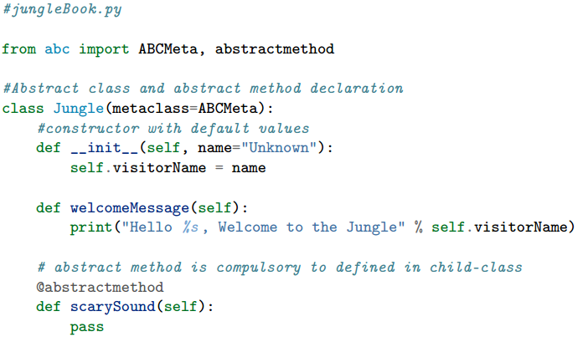
Abstract Class

Slide 27
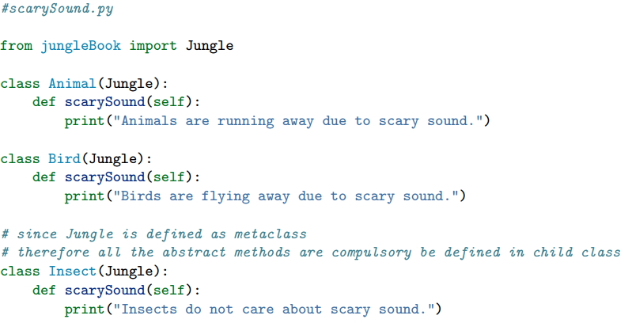
Abstract Class

Slide 28
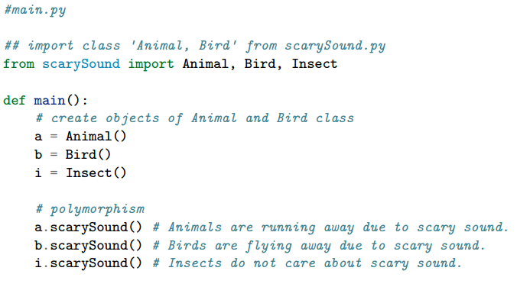
Abstract Class

Slide 29
Interface
In object-oriented languages like Python, the interface is a collection of method signatures that should be provided by the implementing class. Implementing an interface is a way of writing an organized code and achieve abstraction.

Slide 30
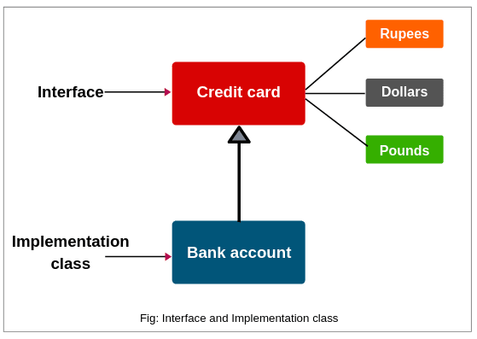
Interface

Slide 31
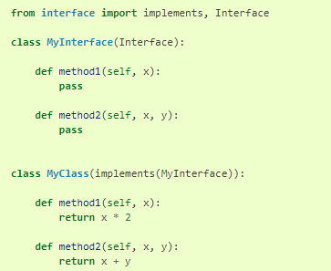
Interface

Slide 32
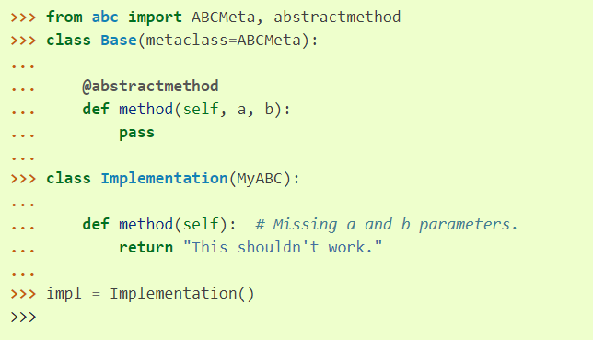
interface vs. abc

Slide 33
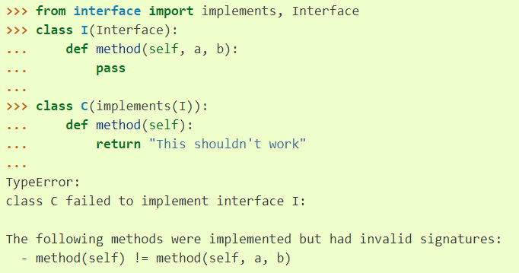
interface vs. abc

Slide 34
Core OOPS concepts
6) Encapsulation
Encapsulation is an OOP technique of wrapping the data and code.
In this OOPS concept, the variables of a class are always hidden from other classes. It can only be accessed using the methods of their current class.

Slide 35
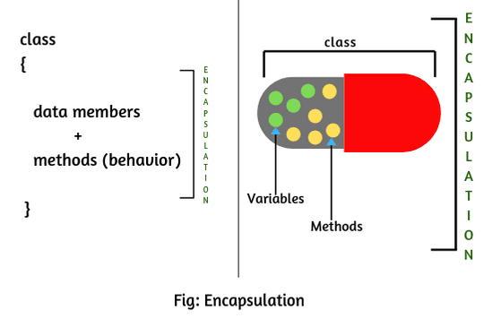
Encapsulation

Slide 36
Encapsulation
Class Employee:
totalEmployee = 0
def __init__ (self, name, salary, age):
self.name = name
self.salary = salary
self.age = age

Slide 37
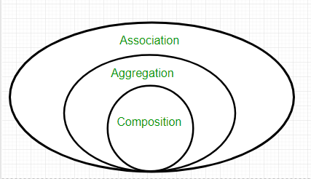
Core OOPS concepts

Slide 38
Core OOPS concepts
7) Association
Association is a relationship between two objects. It defines the diversity between objects.
In this OOP concept, all object have their separate lifecycle, and there is no owner.
For example, many students can associate with one teacher while one student can also associate with multiple teachers.

Slide 39
Association
where objects of the two classes can know about each other, but they do not affect each others lifetime.
The objects can exist independently and which class A object knows about which class B objects can vary over time.

Slide 40
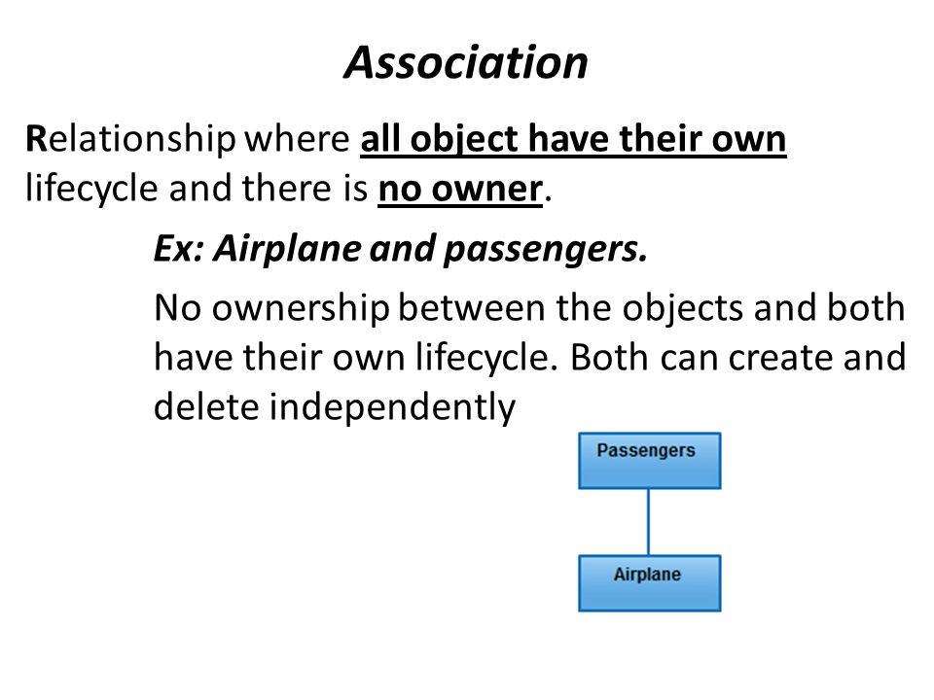

Slide 41
Core OOPS concepts
8) Aggregation
In this technique, all objects have their separate lifecycle. However, there is ownership such that child object can’t belong to another parent object.
For example consider class/objects department and teacher. Here, a single teacher can’t belong to multiple departments, but even if we delete the department, the teacher object will never be destroyed.

Slide 42
Aggregation
It is a special form of Association where:
It represents Has-A relationship.
It is a unidirectional association i.e. a one way relationship. For example, department can have students but vice versa is not possible and thus unidirectional in nature.
In Aggregation, both the entries can survive individually which means ending one entity will not effect the other entity

Slide 43
Aggregation
There is an Institute which has no. of departments like CSE, EE.
Every department has no. of students.
So, we make a Institute class which has a reference to Object or no. of Objects (i.e. List of Objects) of the Department class. That means Institute class is associated with Department class through its Object(s).
Department class has also a reference to Object or Objects (i.e. List of Objects) of Student class means it is associated with Student class through its Object(s).
It represents a Has-A relationship.

Slide 44
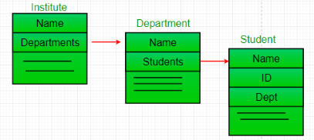
Aggregation

Slide 45
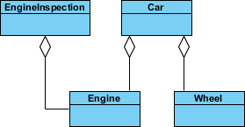

Slide 46
Aggregation
class Car:
def __init__ (self, engine, body):
self.engine = engine
self.body = body
def main:
engine300 = Engine(300)
stealBody = Body(“Steal”)
teslaV2 = Car(engine, stealBody)

Slide 47
Core OOPS concepts
9) Composition
A composition is a specialized form of Aggregation. It is also called "death" relationship. Child objects do not have their lifecycle so when parent object is deleted, then all child object will also be deleted automatically.
For that, let’s take an example of House and rooms. Any house can have several rooms. One room can’t become part of two different houses. So, if you delete the house, room will also be deleted.

Slide 48
Composition
Composition is a restricted form of Aggregation in which two entities are highly dependent on each other.
It represents part-of relationship.
In composition, both the entities are dependent on each other.
When there is a composition between two entities, the composed object cannot exist without the other entity.

Slide 49
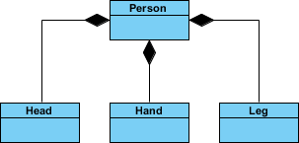

Slide 50
Composition
class Human:
def __init__ (self):
brain = Brain()
heart = heart()
def main:
asif = Human()

Slide 51
Aggregation vs. Composition
Dependency: Aggregation implies a relationship where the child can exist independently of the parent. For example, Bank and Employee and Human and heart.
Type of Relationship: Aggregation relation is “has-a” and composition is “part-of” relation.
Type of association: Composition is a strong Association whereas Aggregation is a weak Association.

Slide 52
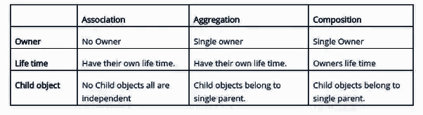
Association vs. Aggregation vs. Composition

Slide 53
Advantages of OOPS:
OOP offers easy to understand and a clear modular structure for programs.
Objects created for Object-Oriented Programs can be reused in other programs. Thus it saves significant development cost.
Large programs are difficult to write, but if the development and designing team follow OOPS concept then they can better design with minimum flaws.
It also enhances program modularity because every object exists independently.

Slide 54
Thanks to the References:
Wikipedia
Advance Python Tutorials by Meher Krishna Patel
Python Official tutorial
Geeksforgeeks
Stackoverflow
Stackexchange
Tutorials Point
https://www.visual-paradigm.com/guide/uml-unified-modeling-language/uml-aggregation-vs-composition/
https://www.geeksforgeeks.org/association-composition-aggregation-java/

Slide 55


